Slide 1


Lecture 10
Produced by Dr. Worldwide
Welcome to the 305
~
~

Slide 2

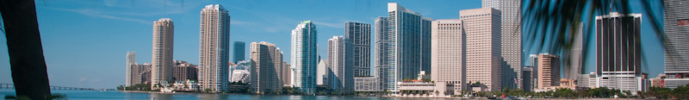
Special Types of Models
Special linear programming problems
Transportation
Transshipment
Assignment
Subset of network flow problems

Slide 3
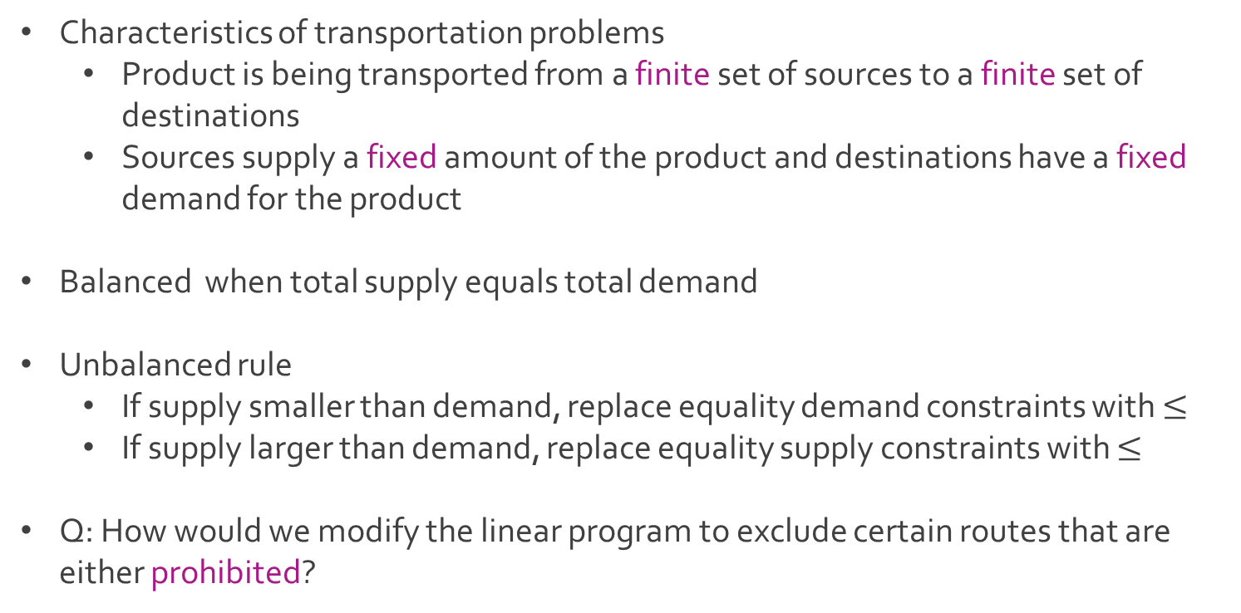
Transportation
Characteristics of transportation problems
Product is being transported from a finite set of sources to a finite set of destinations
Sources supply a fixed amount of the product and destinations have a fixed demand for the product
Balanced when total supply equals total demand
Unbalanced rule
If supply smaller than demand, replace equality demand constraints with $≤$
If supply larger than demand, replace equality supply constraints with $≤$
Q: How would we modify the linear program to exclude certain routes that are either prohibited?

Slide 4
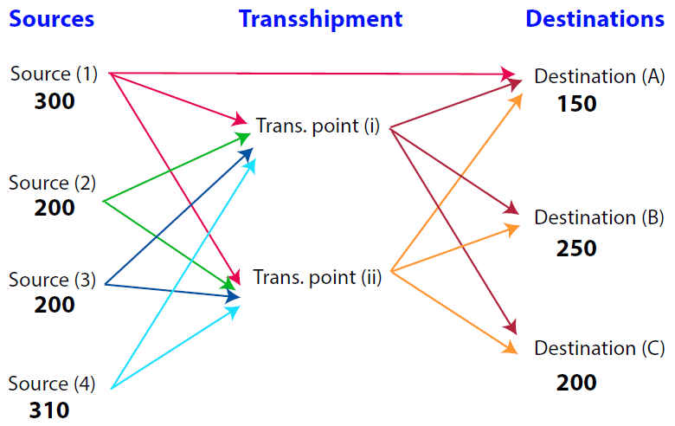
Transshipment
Extension of the transportation model
Diagram of transshipment problem
Q: What is the difference between transportation and transshipment?

Slide 5
Transshipment
Transshipment adds intermediate transshipment points between the sources and the destinations
Possible routes in transshipment models
Sources to transshipment points
Transshipment points to destinations
Sources to destinations
Book also states routes can exist between sources and between destinations
Classic example of transshipment points are warehouses

Slide 6
Ex: Transporting Grain Again
Farms to grain elevators to flour mills
Table of locations
Nebraska and Colorado have become the sources of the wheat
Each of the two farms produces 300 tons of wheat
Kansas City, Omaha, and Des Moines have become our transshipment points
Farms | Grain Elevator | Flour Mills
1. Nebraska | 3. Kansas City | 6. Chicago
2. Colorado | 4. Omaha | 7. St. Louis
 | 5. Des Moines | 8. Cincinnati

Slide 7
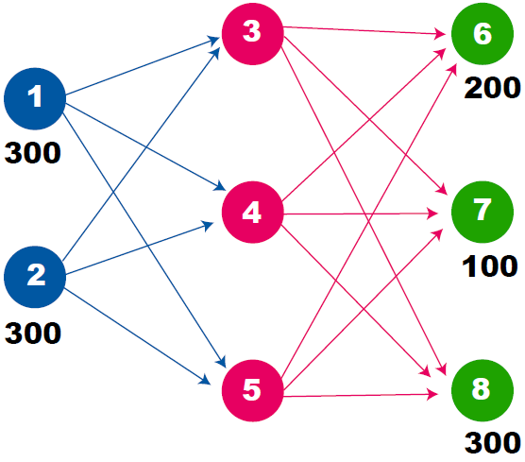
Ex: Transporting Grain Again
General diagram of transshipment problem

Slide 8
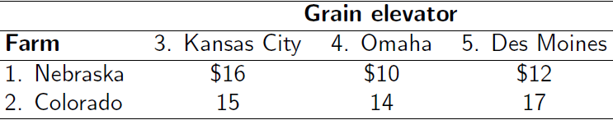
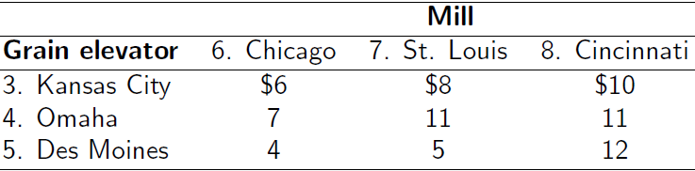
Ex: Transporting Grain Again
Shipping costs from farms to the grain elevators
Shipping costs from grain elevators to flour mills

Slide 9
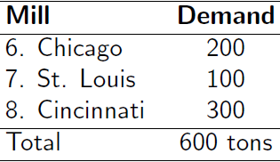

Ex: Transporting Grain Again
Demand from flour mills
Q: How to transport grain (in tons) from farms to flour mills with minimal costs?
Decision variables
$x_{ij}=number of tons of grain to ship from i to j$
$i,j∈\left\{1,2,3,4,5,6,7,8\right\}$ and $i≠j$

Slide 10
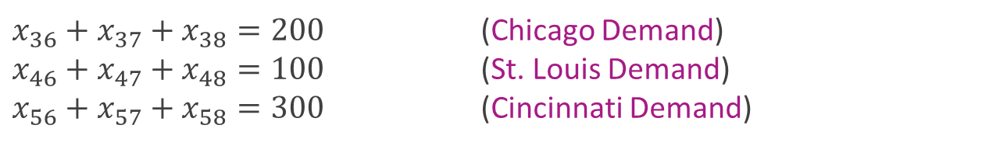
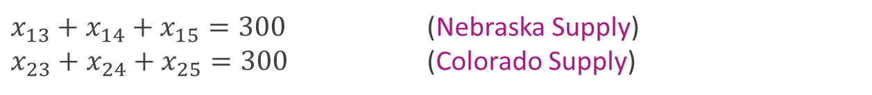
Ex: Transporting Grain Again
Objective function
In this problem, total supply (600) equals total demand (600)
Supply constraints
Demand constraints
$Z=16x_{13}+10x_{14}+12x_{15}+15x_{23}+14x_{24}+17x_{25}$
$+ 6x_{36}+8x_{37}+10x_{38}+7x_{46}+11x_{47}+11x_{48}+4x_{56}+5x_{57}+12x_{58}$
$x_{13}+x_{14}+x_{15}=300$ (Nebraska Supply)
$x_{23}+x_{24}+x_{25}=300$ (Colorado Supply)
$x_{36}+x_{37}+x_{38}=200$ (Chicago Demand)
$x_{46}+x_{47}+x_{48}=100$ (St. Louis Demand)
$x_{56}+x_{57}+x_{58}=300$ (Cincinnati Demand)

Slide 11
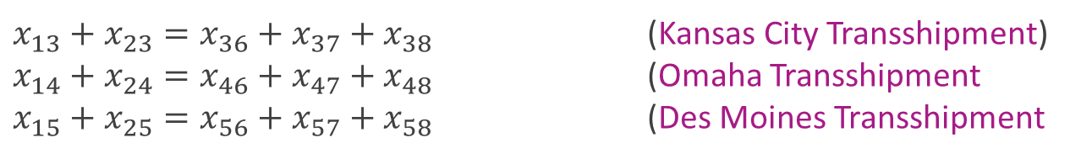
Ex: Transporting Grain Again
Transshipment points have constraints that express equality between what goes in and what goes out
Transshipment constraints
Integer constraints
Download MillsTransship.xlsx from course website from link Sheet 1
Try to find the solution using Excel Solver
$x_{13}+x_{23}=x_{36}+x_{37}+x_{38}$ (Kansas City Transshipment)
$x_{14}+x_{24}=x_{46}+x_{47}+x_{48}$ (Omaha Transshipment
$x_{15}+x_{25}=x_{56}+x_{57}+x_{58}$ (Des Moines Transshipment
$$x_{ij}∈\{0,1,2,⋯\}$$
$$x_{15}=300 \& x_{24}=300 \& x_{48}=300 \& x_{56}=200 \& x_{57}=100$$

Slide 12
Assignment
Similar to the transportation model with slight difference
In the assignment model, the supply at each source and demand at each destination is exactly one
Think of the sources as unique units that need to be assigned to specific recipients
There is cost associated to each pair of source and destination

Slide 13
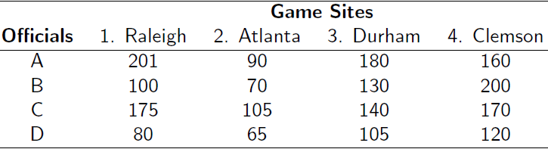
Ex: ACC Officials
Four basketball games in the Atlantic Coast Conference (ACC) on a night
Conference wants to assign four teams of officials to the four games
Supply is always one team of officials
Demand is always requiring only one team of officials
Q: How should we assign the four teams of officials so that distance is minimized?

Slide 14
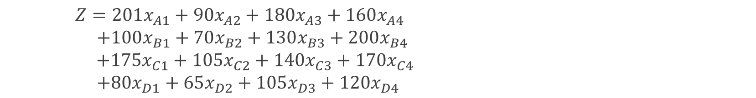

Ex: ACC Officials
Decision variables
$x_{ij}=indicator of whether official team i is assigned to game in city j$
$i∈\left\{A,B,C,D\right\}$
$j∈\left\{1,2,3,4 \right\}$
Objective function
Use multiple choice constraints to ensure supply fulfills demand
$Z=201x_{A1}+90x_{A2}+180x_{A3}+160x_{A4}$
$+100x_{B1}+70x_{B2}+130x_{B3}+200x_{B4}$
$+175x_{C1}+105x_{C2}+140x_{C3}+170x_{C4}$
$+80x_{D1}+65x_{D2}+105x_{D3}+120x_{D4}$

Slide 15
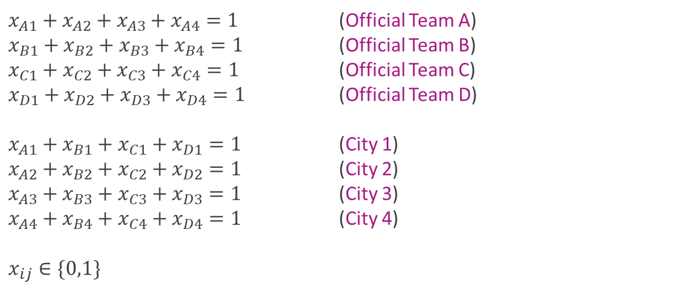
Ex: ACC Officials
Constraints
$x_{A1}+x_{A2}+x_{A3}+x_{A4}=1$ (Official Team A)
$x_{B1}+x_{B2}+x_{B3}+x_{B4}=1$ (Official Team B)
$x_{C1}+x_{C2}+x_{C3}+x_{C4}=1$ (Official Team C)
$x_{D1}+x_{D2}+x_{D3}+x_{D4}=1$ (Official Team D)
$x_{A1}+x_{B1}+x_{C1}+x_{D1}=1$ (City 1)
$x_{A2}+x_{B2}+x_{C2}+x_{D2}=1$ (City 2)
$x_{A3}+x_{B3}+x_{C3}+x_{D3}=1$ (City 3)
$x_{A4}+x_{B4}+x_{C4}+x_{D4}=1$ (City 4)
$$x_{ij}∈\{0,1\}$$

Slide 16




The End
Dale

